Slide 1
1:1 meeting with Peter
06/09/2023
Jamie Park

Slide 2
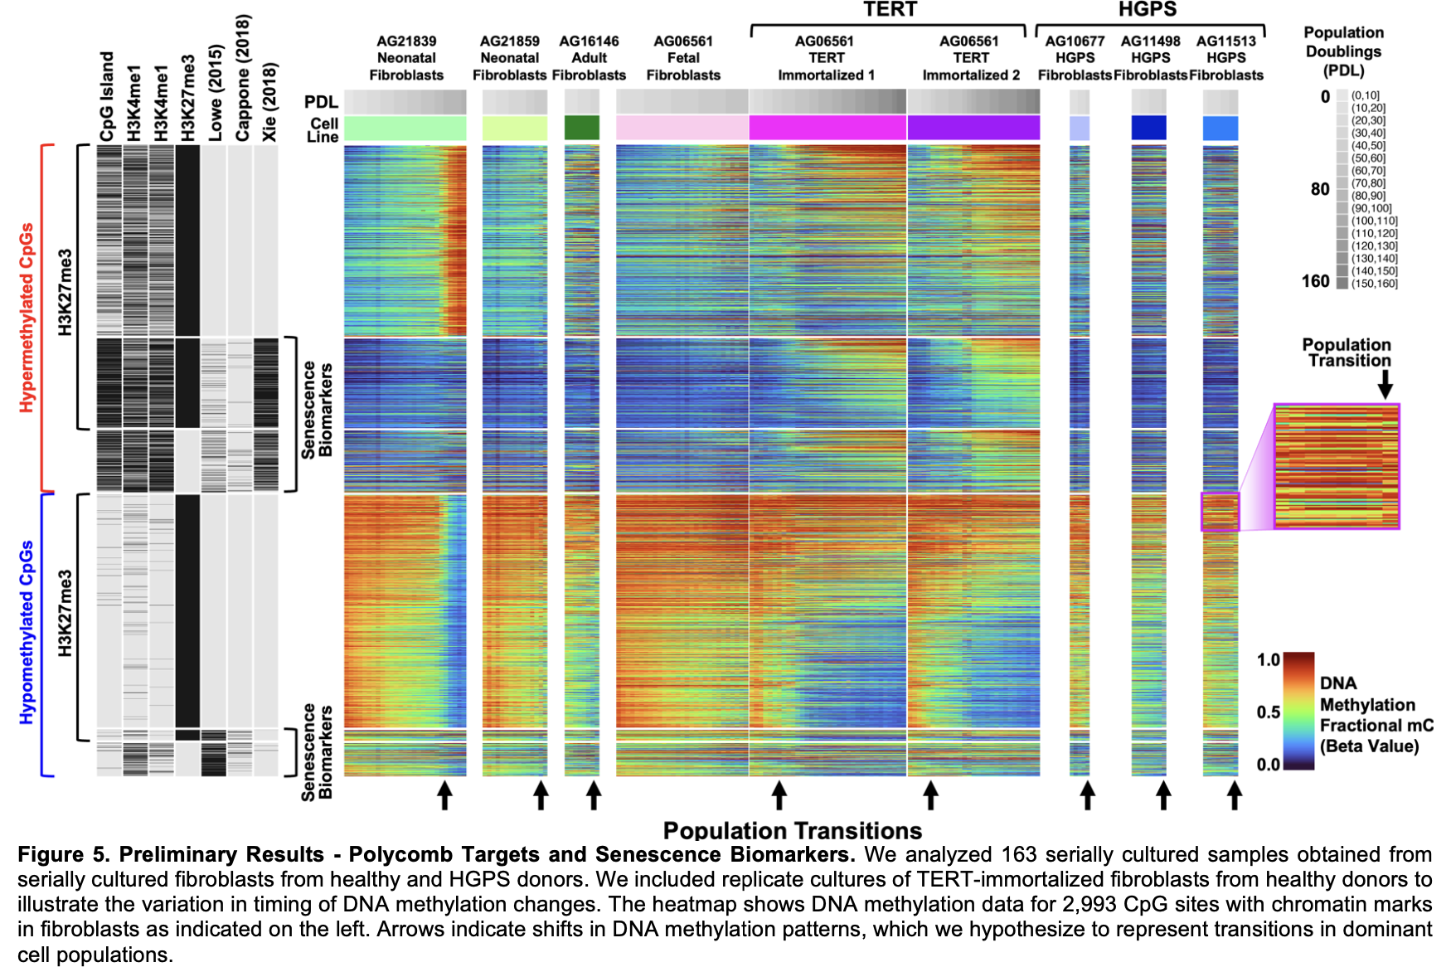
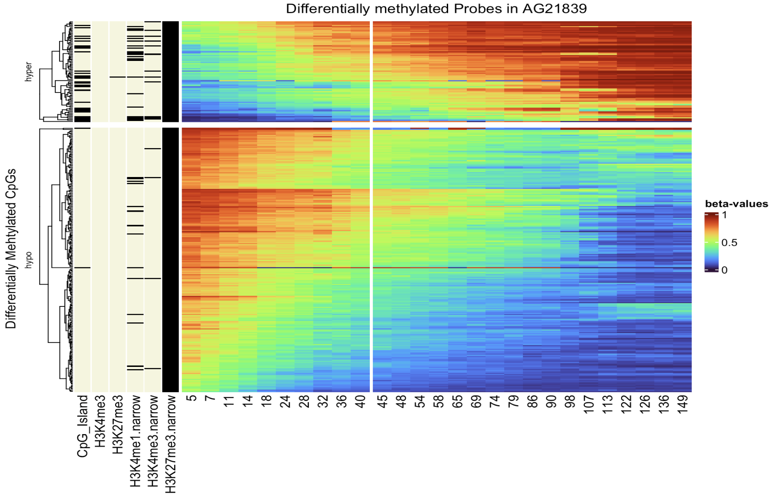
\

Slide 3
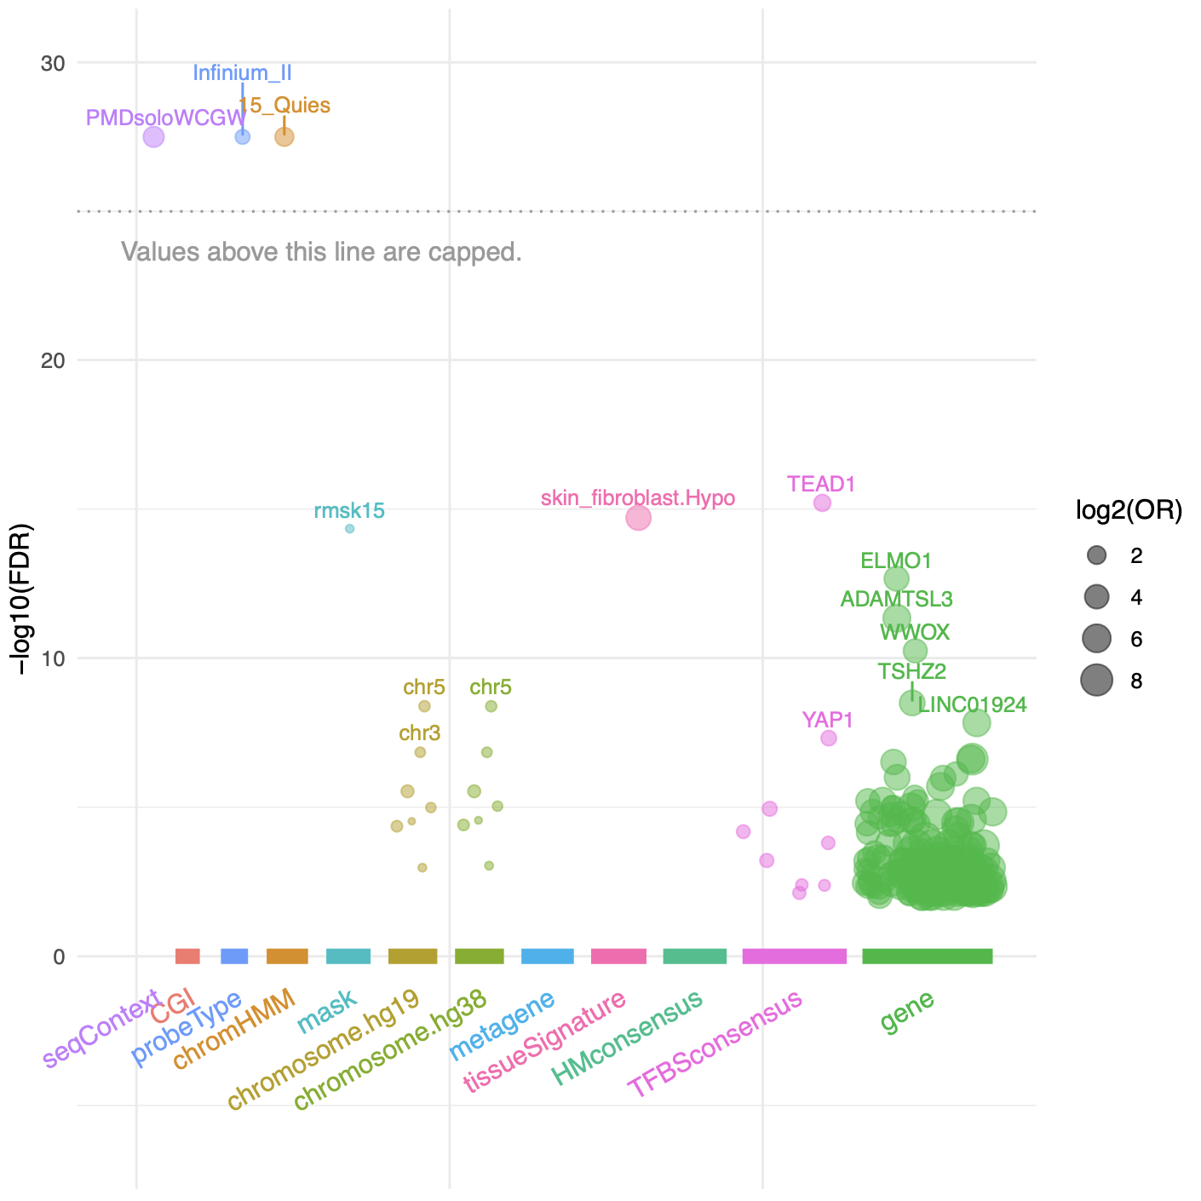
this week;
talk to Emily and do some math.
Fulgent(Novaseq10) vs. VAI core
can submit library?
4 additional analysis
making a “window” for peaks
epigenome_roadmap peak plugin.
SNP consistency across probes
population shift?
AG21859 dataset analysis
same individual; diff celltype
CNV analysis; “Chr3 and 5"

Slide 4
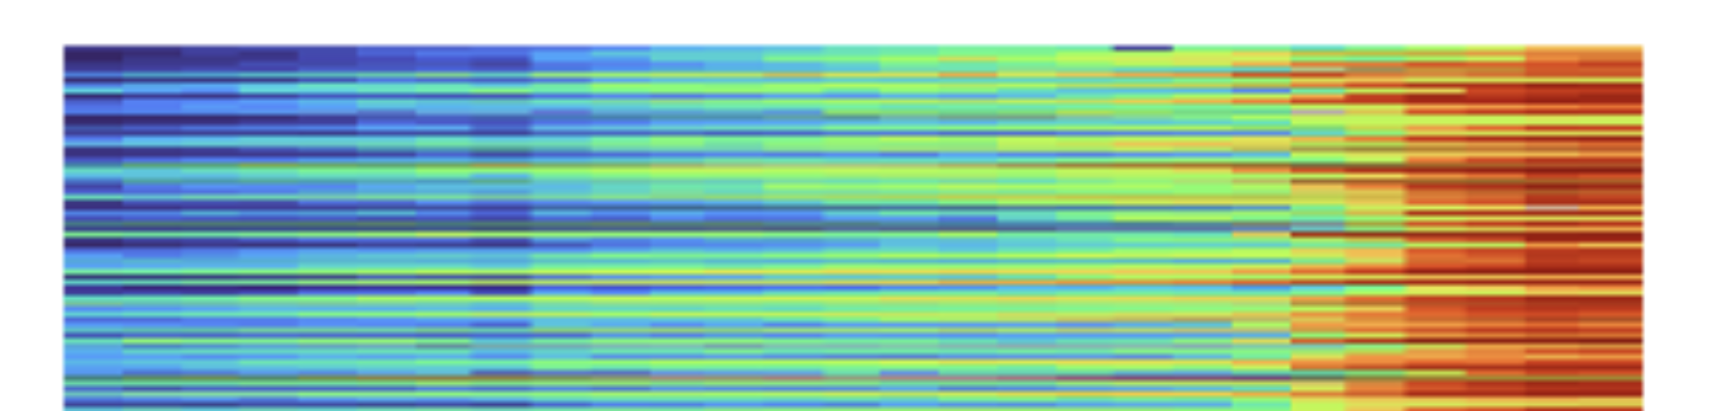

Slide 6
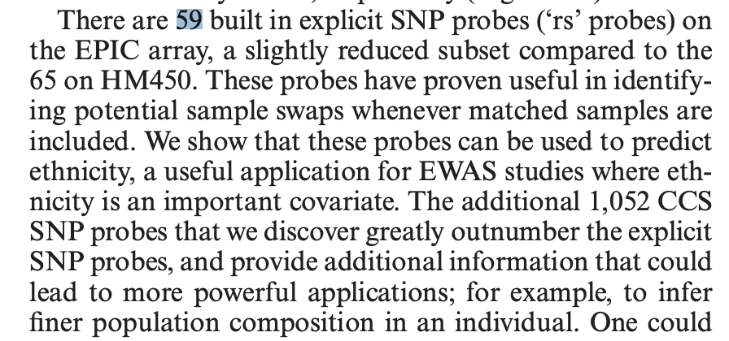
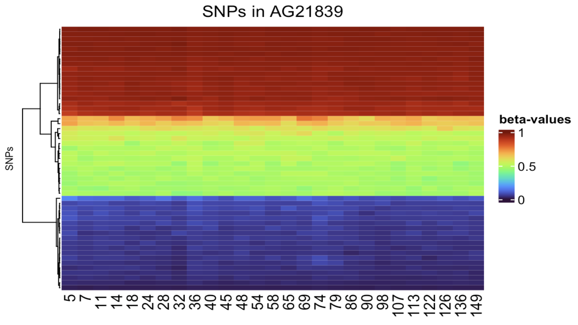
59 SNPs on AG21839

Slide 7
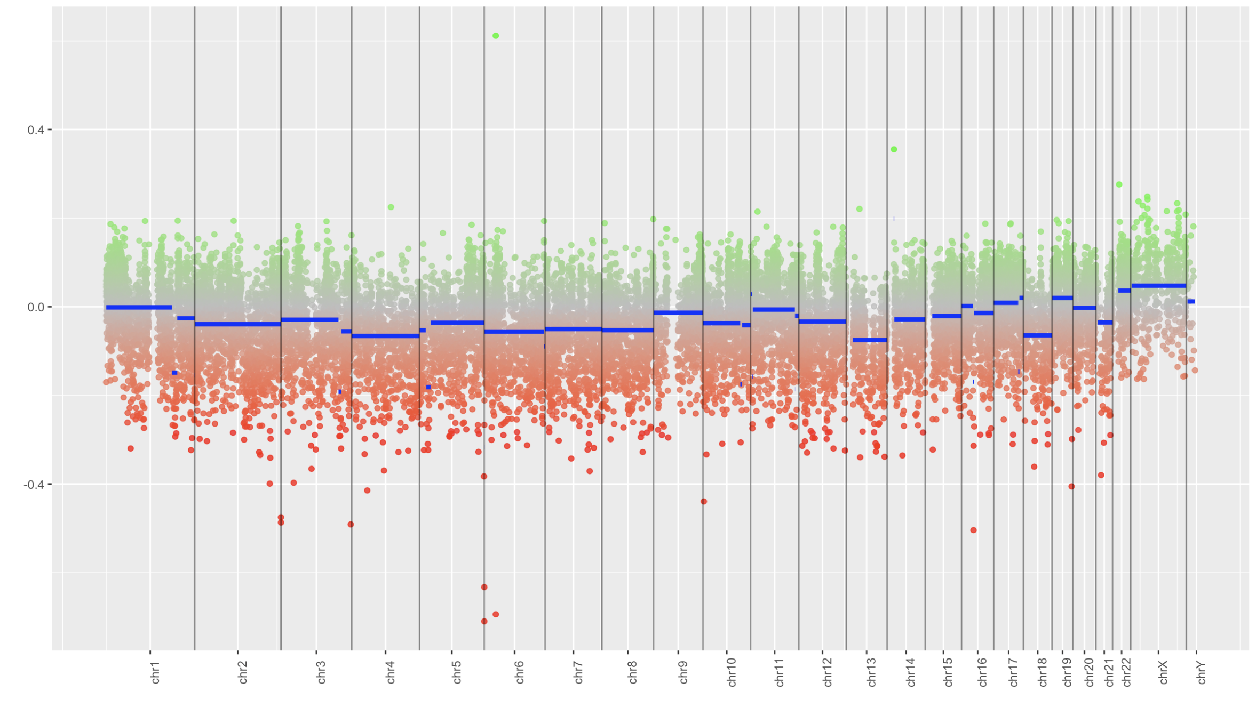
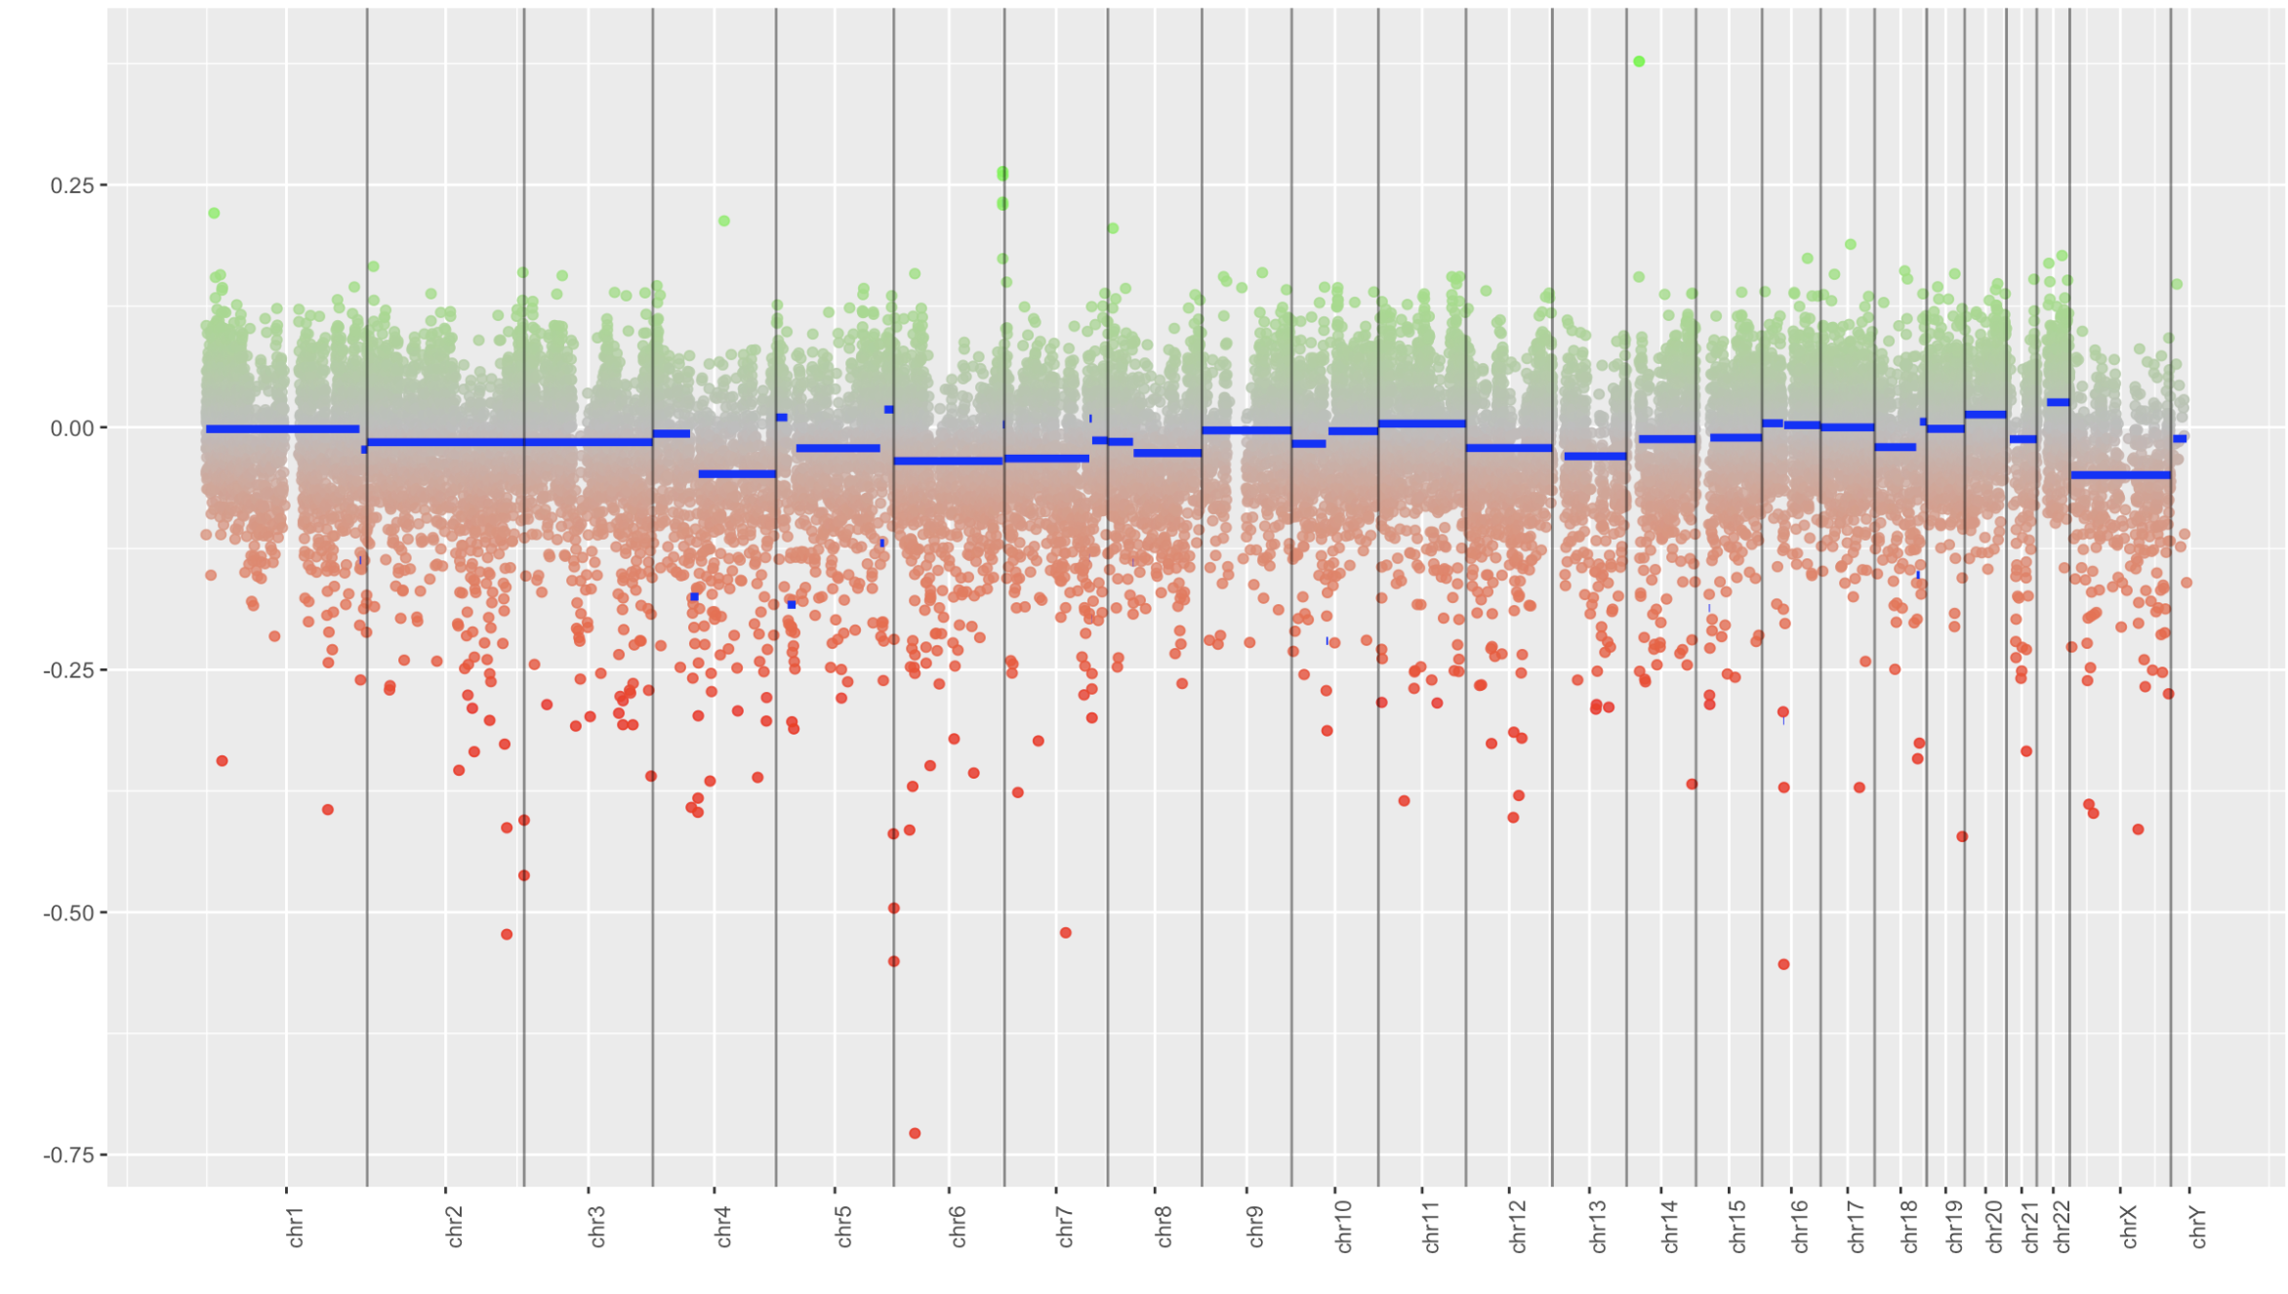
CNV inference
early passage[1]
late passage[27]

Slide 8
Epi conference.
GRC : Epigenetic Information: Mechanisms, Memory and Inheritance
https://www.grc.org/epigenetics-conference/2023/
August 6 - 11, 2023 at NH.
Ting Wu is coming!
Lots of plant biologists.
CSHL; Mechanisms of Eukaryotic Transcription
August 29 - September 2, 2023

Slide 9
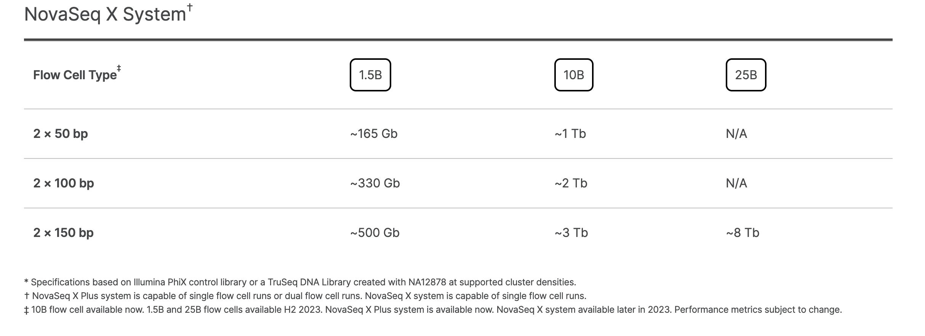
Novaseq X
3.3 Gb (human genome) * 30x coverage = ~100Gb per sample.
4 timepoints = requires 1 lane at 1.5B flowcell
total = ~$ 2200 (45% lower than VAI core internal pricing)
 | per lane
Novagene | $2,199
Discovery | $2,250
Fulgent | $2,140
https://www.illumina.com/systems/sequencing-platforms/novaseq-x-plus/specifications.html

Slide 10
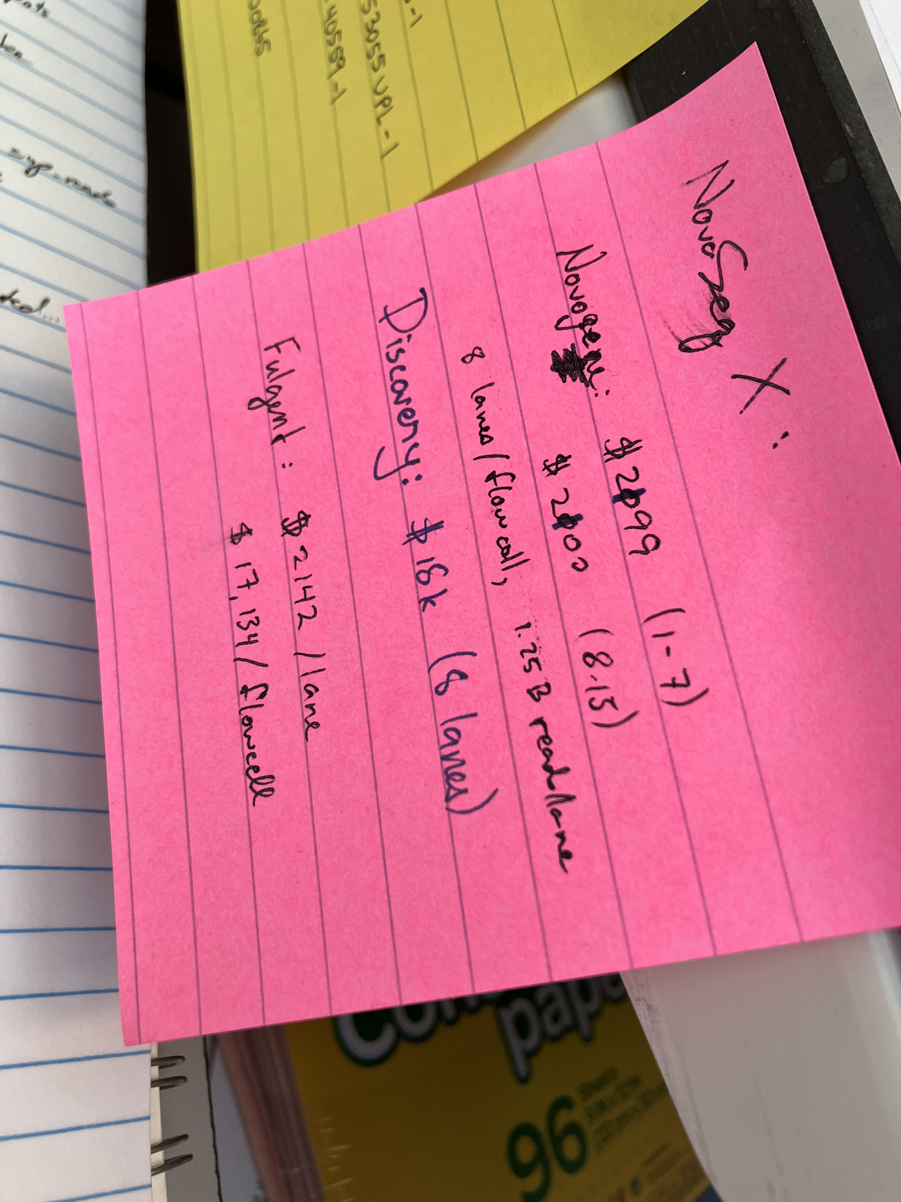
thanks nathan!

